Slide 1

Explore Model Kinship For Merging LLMs
Yedi Hu
Zhejiang University

Slide 2
Overview
01 Background and Motivation
Model Merging: History & Methodology
Model Evolution: Success & Challenges
02 Methods and Preliminary Analysis
Definition of Model Kinship
Model Kinship Analysis on Community Experiments
03 Experimental Results and Underlying Mechanisms
Main Experimental Results
Discussion

Slide 3
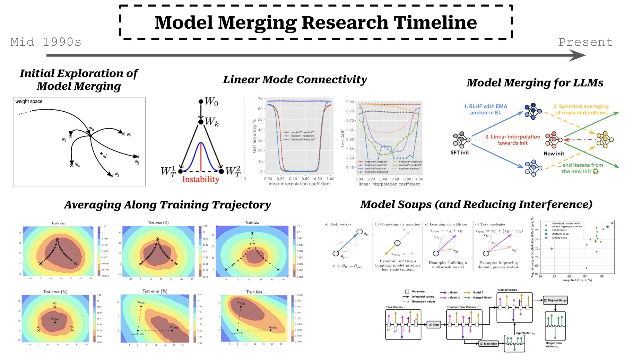
Quick view: Model Merging Research Timeline
Initial Model Merging
Averaging along the training trajectory
Linear mode connectivity
Various merging approaches
Model Merging in
LLMs
Modified from https://x.com/cwolferesearch/status/1828567528710513141

Slide 4
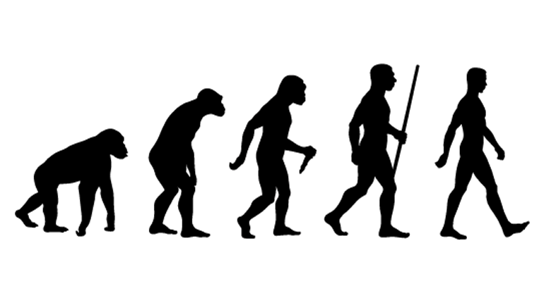
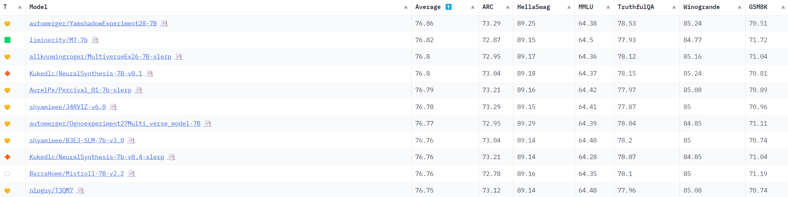
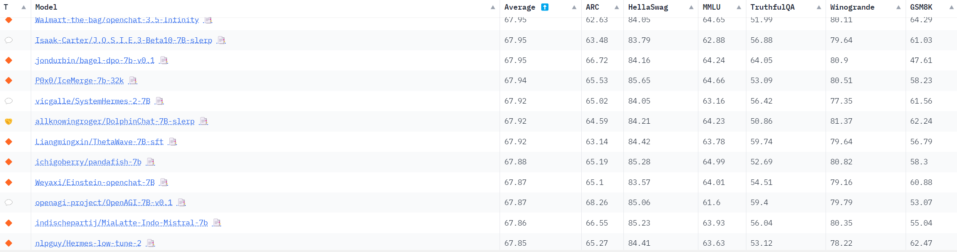

Community Experiments
Hugging face
Open Leaderboard
Model merging toolkits such as Mergekit enable users with limited expertise to easily conduct merging experiments, leading to an evolution of LLMs for the community.
…
Just for Mistral-7B
More than 500 merged models
https://huggingface.co/spaces/open-llm-leaderboard-old/open_llm_leaderboard

Slide 5
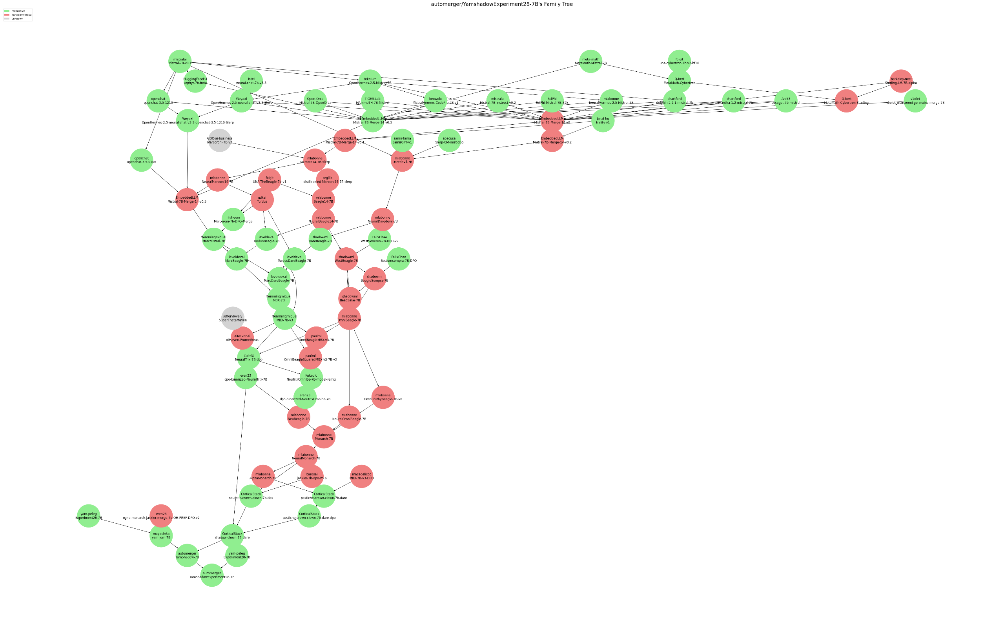


Model Evolution
Foundation Models:
~ 67 Avg.
Model Family Tree of
Model Evolution
Nearly 70
merges!
Final Model:
76.86 Avg.

Slide 6

How is Model Evolution achieved ?
Iterative Merging
Improving LLMs via iterative process
Select
Select potential models for the next merge using a specific strategy (e.g. performance-prior)
Merge
Merge selected models via model merging approach (e.g. Linear Averaging)
Recycle
Recycle merged model to Model Repository for future merging.
🤔Select
…
♻️Recycle
Model Repository
🤗Merge

Slide 7










Merging Challenges
6
Track foundation models?
Possible for early merged models.
Difficult for merged models after multiple merges.
Compare each task performance?
Possible for comparison between 2 or 3 tasks.
Difficult for merging multiple tasks.
Highest average task performance?
Easy to identify.
Potential problems?
Math Model
M+C Model
…
6
…
Code Model
…
Merged Model
Pre-Trained
Model
Instruct Model
C+I Model
…
Merged Model
……
…
How to select?
……
How can we select models after multiple merges?
What else can we do?

Slide 8
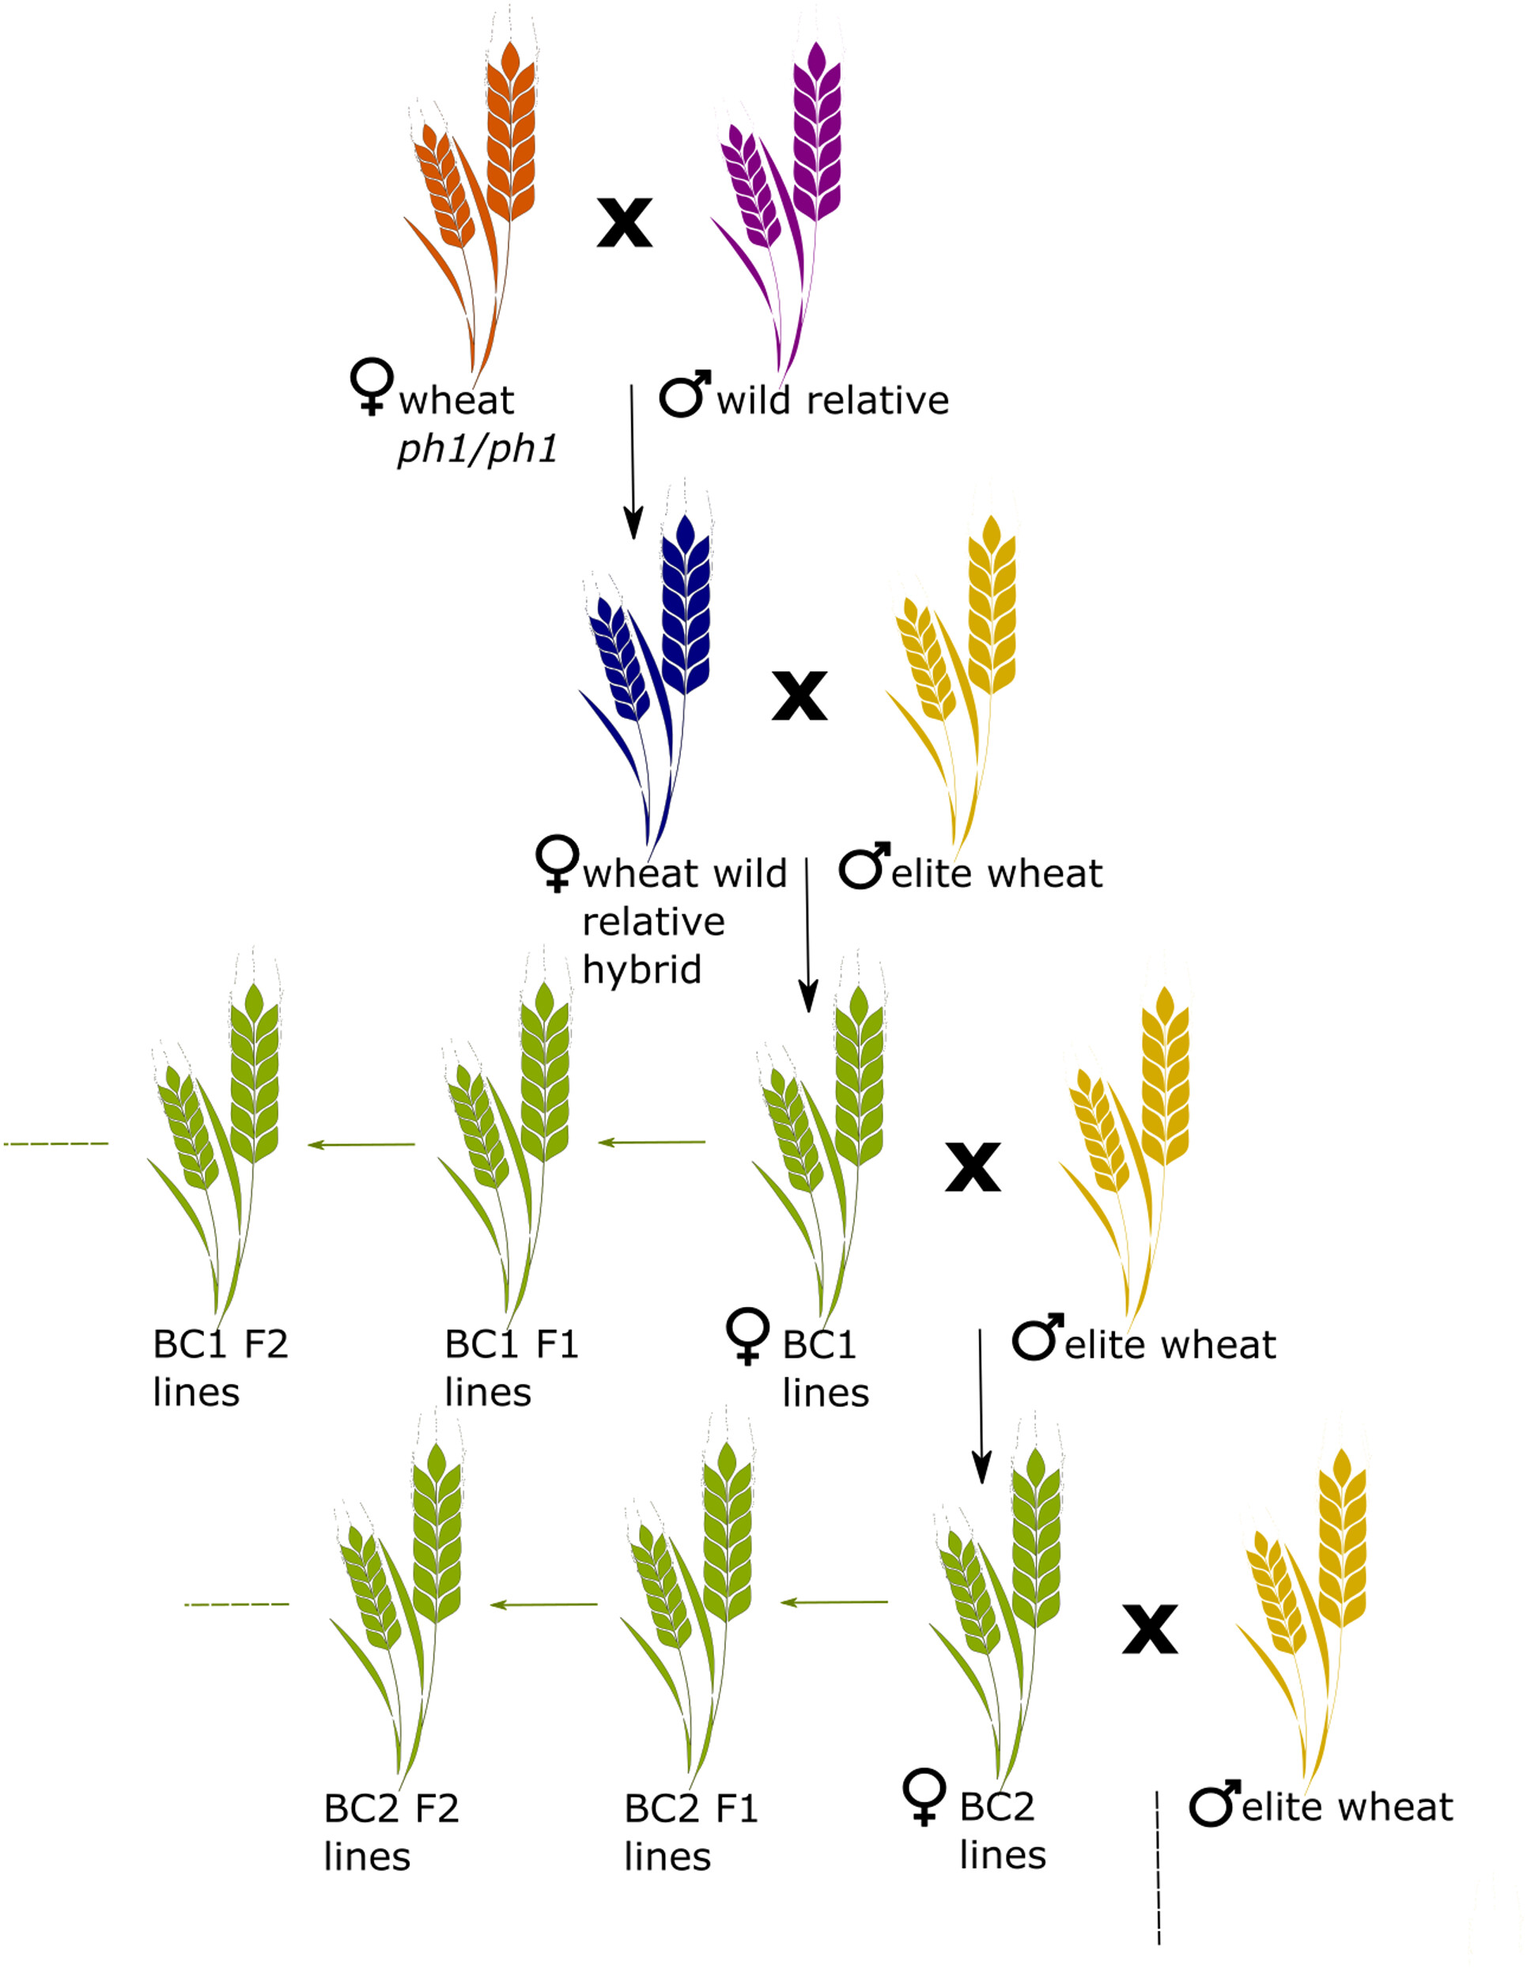
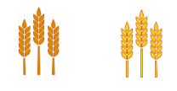


Artificial Evolution in Biology
Hybridization
Inbred populations are more likely to suffer from genetic conditions caused by recessive gene variants, resulting in Inbreeding Depression
Selective breeding involves choosing parents with particular characteristics to breed together and produce offspring with more desirable characteristics.
Selective Breeding
Gen 1
Inbreeding
Depression
High
Kinship
Gen 2
else
Laugerotte et. al’22
Gen 3

Slide 9







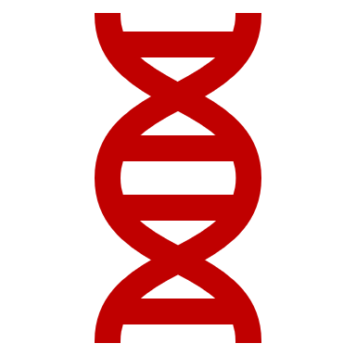



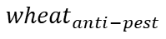
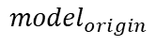
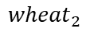
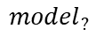
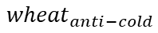
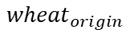
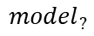
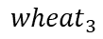
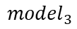
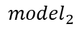
Wheat Evolution vs. Model Evolution
(a) Wheat Evolution through Breeding
Idea:
Kinship for LLMs?
Hybridize
Hybridize
$${wheat}_{origin}$$
$${wheat}_{2}$$
$${wheat}_{3}$$
⭐high-yield
⭐high-yield
⭐high-yield
❄️anti-cold
$${wheat}_{anti−cold}$$
❄️anti-cold
$${wheat}_{anti−pest}$$
❄️anti-cold
🦗anti-pest
Low
Kinship
Low
Kinship
🦗anti-pest
🦗anti-pest
(b) Model Evolution through Merging
Merge
Merge
$${model}_{origin}$$
$${model}_{2}$$
$${model}_{3}$$
💬commonsense
💬commonsense
💬commonsense
$${model}_{?}$$
$${model}_{?}$$
Model Kinship
📐mathematics
📐mathematics
📐mathematics
🔬science
Ability
Unknown
🔬science
Ability
Unknown
🔬science

Slide 10
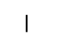
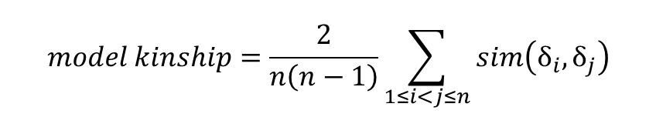

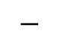
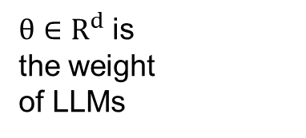
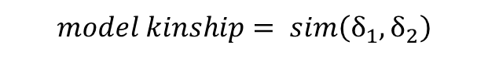
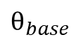
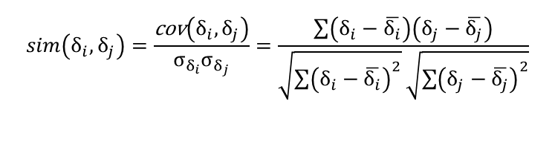
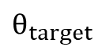

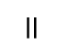
Model Kinship
Merging two models
Delta Parameters
$θ∈R^{d}$ is
the weight
of LLMs
$$model kinship= sim\left(δ_{1},δ_{2}\right)$$
$$δ_{\text{target}}=θ_{\text{target}}−θ_{\text{base}}$$
similarity metric
…
$$δ_{\text{target}}$$
…
e.g. adopt Pearson Correlation Coefficient as similarity metric:
…
$$θ_{target}$$
$$−$$
$$sim\left(δ_{i},δ_{j}\right)=\frac{\text{cov}\left(δ_{i},δ_{j}\right)}{σ_{δ_{i}}σ_{δ_{j}}}=\frac{\sum{\left(δ_{i}−\overline{δ_{i}}\right)\left(δ_{j}−\overline{δ_{j}}\right)}}{\sqrt{\sum{{\left(δ_{i}−\overline{δ_{i}}\right)}^{2}}}\sqrt{\sum{{\left(δ_{j}−\overline{δ_{j}}\right)}^{2}}}}$$
$$−$$
…
…
…
$$θ_{base}$$
$$=$$
Merging multiple models
…
$$δ_{\text{target}}$$
$$model kinship=\frac{2}{n\left(n−1\right)}\sum_{1≤i<j≤n}{sim\left(δ_{i},δ_{j}\right)}$$
…

Slide 11
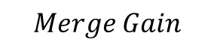

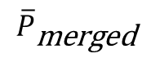
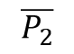
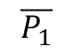
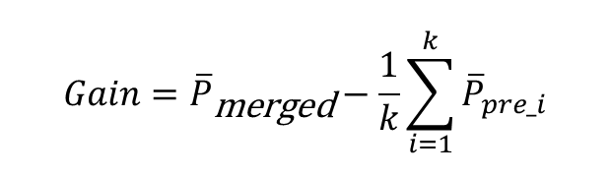
Additional Metrics
Merge Gain
$$Gain={\overline{P}}_{\text{merged}}−\frac{1}{k}\sum_{i=1}^{k}{{\overline{P}}_{pre_i}}$$
Average Task Performance
$$\overline{P}=\frac{1}{n}\sum_{i=1}^{n}{\overline{P_{i}}}$$
$$Merge Gain$$
Average Task Performance
$$\overline{P_{1}}$$
$$\overline{P_{2}}$$
$${\overline{P}}_{\text{merged}}$$

Slide 12
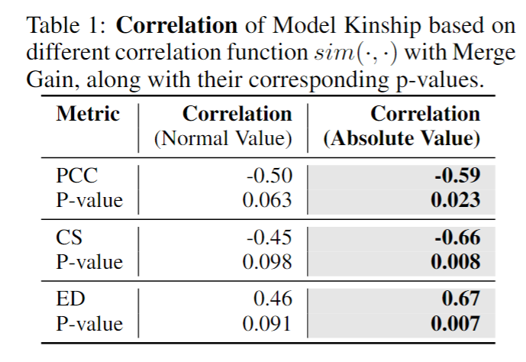

Correlation: Model Kinship and Merge Gain
PCC Distribution
CS Distribution
ED Distribution
4
4
4
4
4
4
3
3
3
3
3
3
Initial conclusion:
Farthest model kinship means higher merge gain
2
2
2
2
2
2
Merge Gain
Merge Gain
Merge Gain
1
1
1
1
1
1
0
0
0
0
0
0
0.0
0.2
0.4
0.6
0.8
1.0
0.0
0.2
0.4
0.6
0.8
1.0
0
5
10
15
20
25
Model Kinship(PCC)
Model Kinship(CS)
Model Kinship(ED)
Bias from users?
Conclusion:
Farthest model kinship means higher variation in merge performance
Reject
Accept
Stronger Correlation
More Confidence

Slide 13
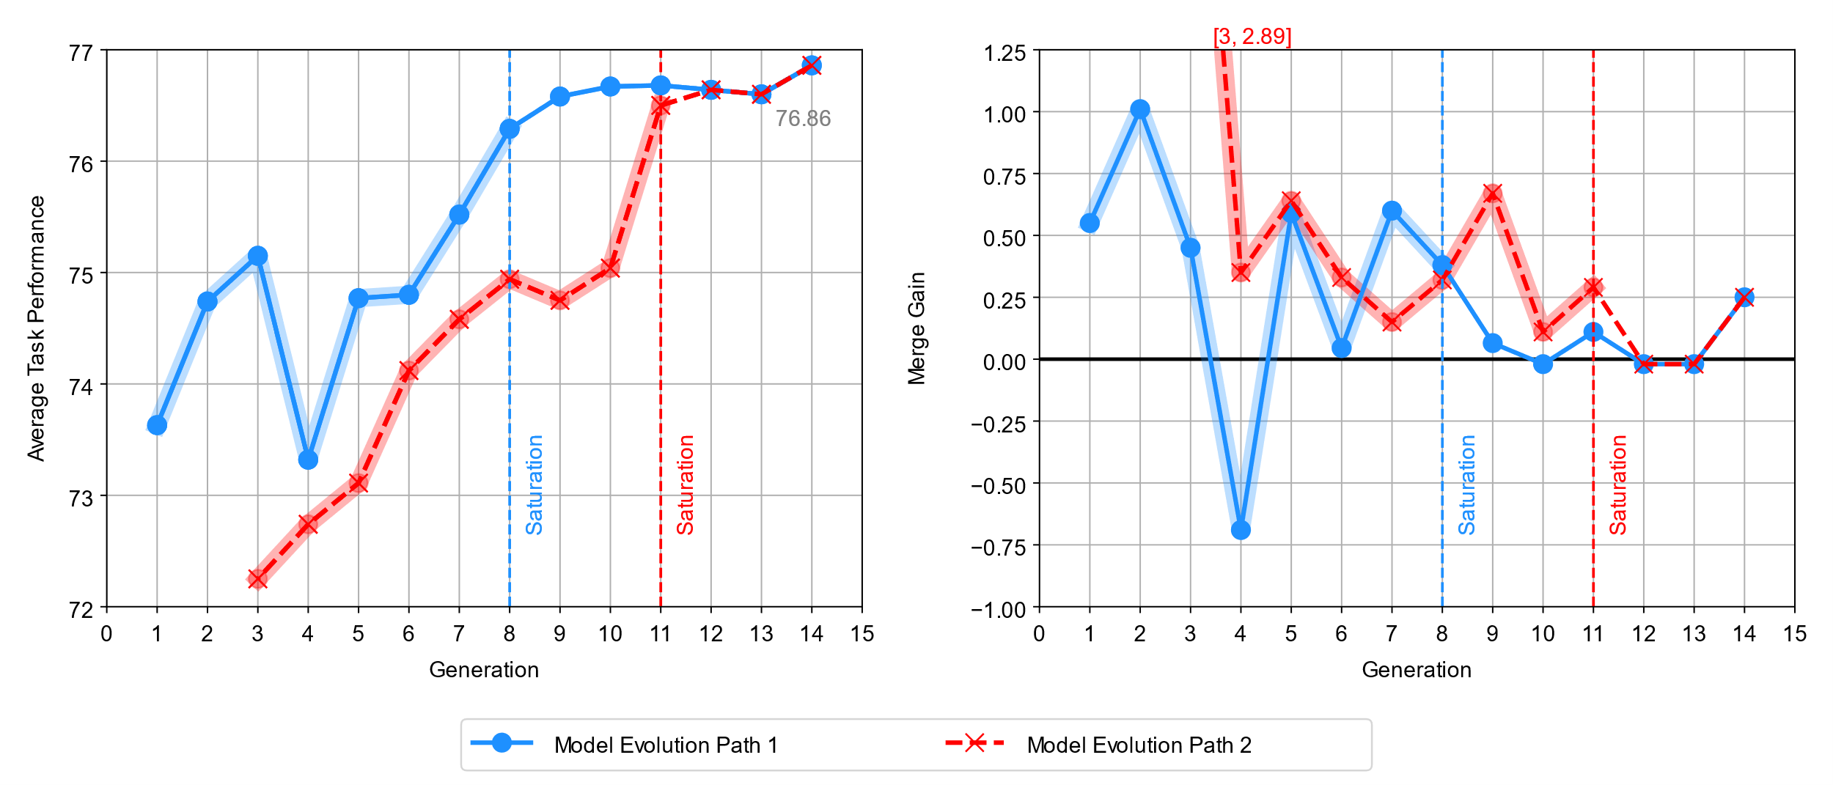
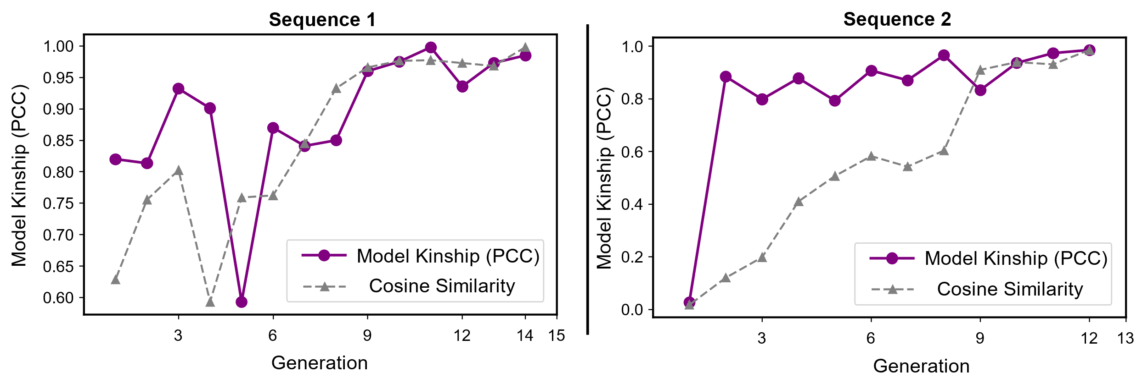
Analysis of Model Evolution Paths
Learning Stage
the average task performance generally experiences a rapid increase.
Saturation Stage
the model can no longer benefit from the merging process and has ceased to improve
Why does evolution stop?

Slide 14



Model Kinship within Different Stage
Early Stage
Learning Stage
Saturation Stage
1.0
Zephyr-beta
1.00
0.01
0.10
0.04
0.27
Daredevil
1.00
0.83
0.76
0.80
0.80
YamExp28
1.00
0.98
0.99
0.95
0.82
0.01
1.00
0.02
0.06
0.03
0.8
MetaMath
CatMarcoro14
0.83
1.00
0.72
0.79
0.93
YamShadow
0.98
1.00
0.98
0.94
0.81
0.10
0.02
1.00
0.02
0.13
0.6
Mistral-Ins
Mayo
0.76
0.72
1.00
0.85
0.85
E25
0.99
0.98
1.00
0.95
0.81
0.04
0.06
0.02
1.00
0.10
0.4
Open-chat
Calmesmol
0.80
0.79
0.85
1.00
0.76
Strange24
0.95
0.94
0.95
1.00
0.80
0.27
0.03
0.13
0.10
1.00
0.2
WizardLM-2-chat
Strange4
0.80
0.93
0.85
0.76
1.00
MonaTrix-v6
0.82
0.81
0.81
0.80
1.00
Mistral-Ins
Mayo
E25
MetaMath
Open-chat
Daredevil
Strange4
YamExp28
Zephyr-beta
Calmesmol
YamShadow
Strange24
WizardLM-2-chat
CatMarcoro14
MonaTrix-v6
Model Evolution
Early
Stage
Late
Stage

Slide 15

Convergence of Weight Space
Early
Stage
The weight diversity of the top merged models decreases throughout the evolution.
The evolution progresses toward an optimal set of weights, which could either be a global optimum that fully integrates all information or a local optimum.
Learning
Stage
Saturation
Stage
Global Optima?
Weight Diversity

Slide 16
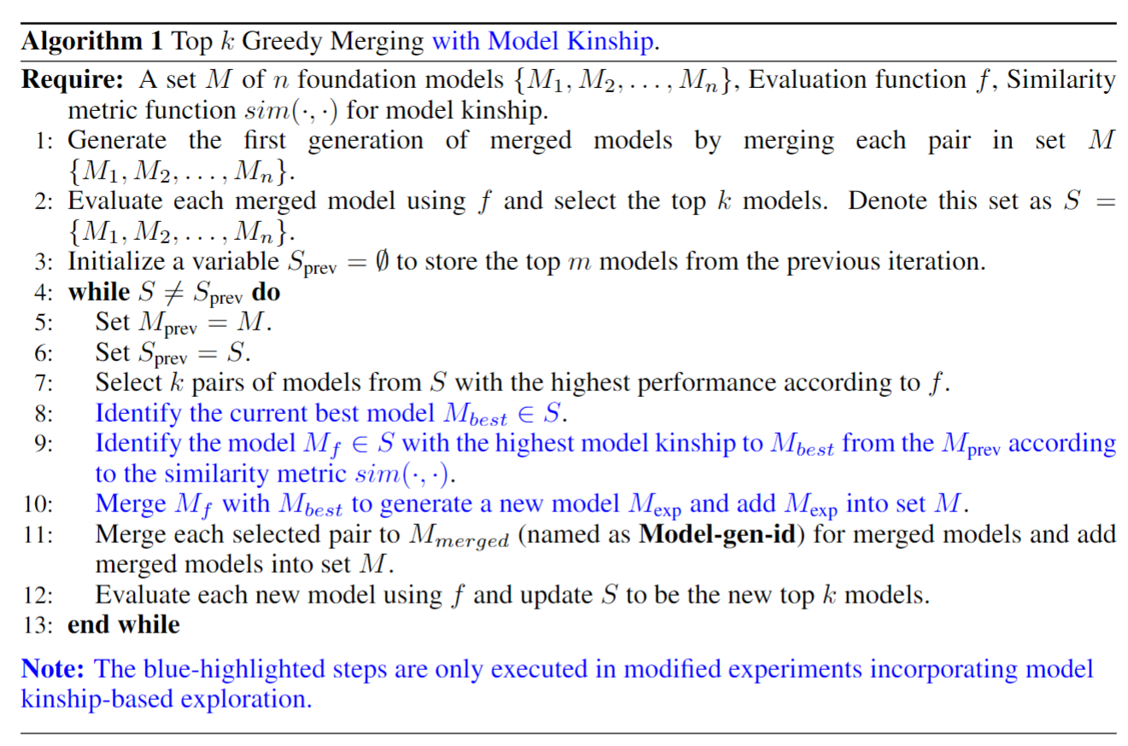
Methodology
Initialization
Iterative Merging

Slide 17
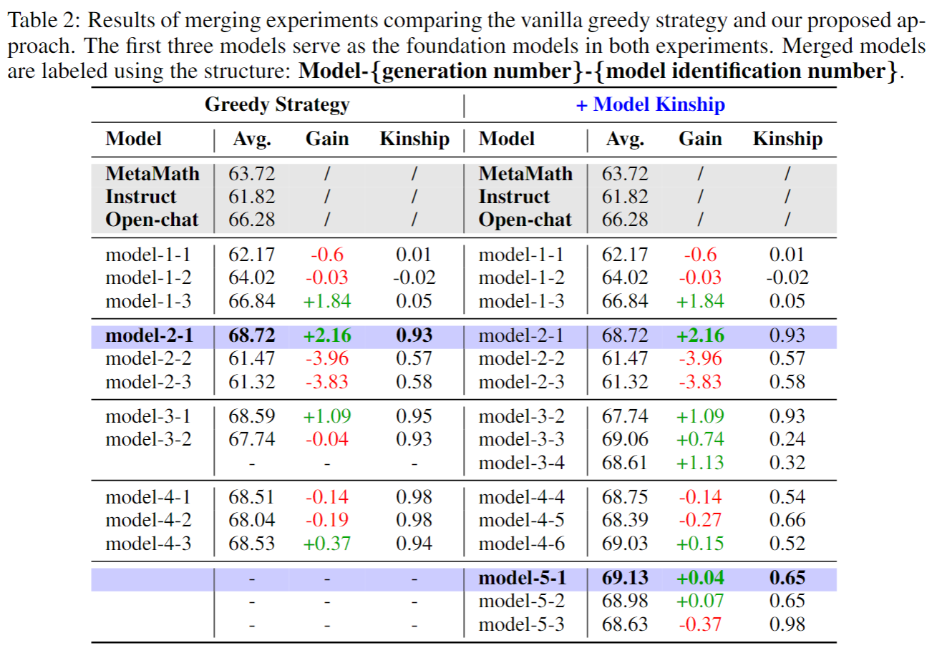
Main Experiment Results
Same selection
Models in each merge are highly related.
Exploration Strategy finds a better evolution path.

Slide 18
Main Experiment Results
69.5
69.13
69.06
69.0
68.72
68.5
Saturation
68.0
Best Average Task Performance
67.5
67.0
66.5
Greedy
Ours
66.0
0
1
2
3
4
5
Generation
Exploration Strategy enable evolution to continue.

Slide 19
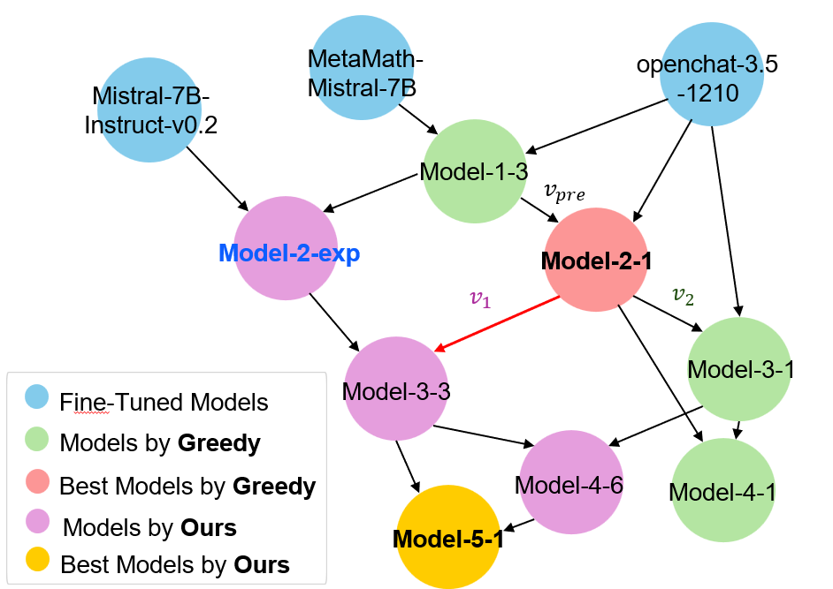
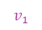
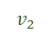
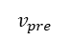
Weight Change in Bifurcation point
$$v_{1}$$
$$v_{pre}$$
$$v_{2}$$
Layer 1
100
Layer 2
Layer 3
Layer 4
Layer 5
Layer 6
Layer 7
Layer 8
Layer 9
Opposite direction
&
Stronger
change
Layer 10
Layer 11
Layer 12
Layer 13
Layer 14
Layer 15
Layer 16
0
Layer 17
Layer 18
Layer 19
Layer 20
Layer 21
Layer 22
Layer 23
Layer 24
Layer 25
Layer 26
Layer 27
Layer 28
Model Tree (Bifurcation Point)
Layer 29
Layer 30
Layer 31
Layer 32
−100
Weight change
in different path

Slide 20
Effect of Model Kinship
Merging Models with Low Kinship can improve performance
Expand searching range.
Escape the local optima traps.
Early Stopping at High Kinship can improve Efficiency
Fair trade-off: small performance gains versus large time consumption

Slide 21
Conclusion & Future Work
Model Kinship: An Effective Guiding Metric for Model Evolution
Predict the Merging Outcomes.
Control the Evolution Directions.
More works need to be done
Better similarity metric?
Theoretical framework of Model Evolution?
Support sustainable evolution (with the help of extrapolation[1]) ?
[1] Weak-to-Strong Extrapolation Expedites Alignment (CoRR 2024)

Slide 22
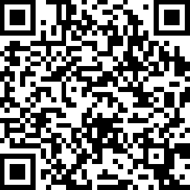
Model Kinship
https://github.com/zjunlp/ModelKinship

